Slide 1


STUDY OF DIGITAL,ANALOG AND MIXED SIGNAL SYSTEMS ACROSS DIFFERENT ARCHITECTURES
AY 2021-25
GITAM UNIVERSITY
Major Project
Project ID: XX
A University should be a place of light, of liberty, and of learning.
Department of Electrical Electronics and Communication Engineering
Project Team:
VORUGUNTLA MOUNIKA -BU21EECE0100376
POLIMERA SANDEEP REDDY –BU21EECE0100080
YERUVA ADITYA UDAYA REDDY-BU21EECE0100294
Project Mentor:
Dr. Prithvi Sekhar Pagala

Slide 2




Project Group – Details
Photo
Track
Roll No
Name
EECE AI/ML
BU21EECE0100376
VORUGUNTLA MOUNIKA
EECE AI/ML
BU21EECE0100080
POLIMERA SANDEEP REDDY
EECE AI/ML
BU21EECE0100294
YERUVA ADITYA UDAYA REDDY

Slide 3
Overview and Goals
Overview
The study of digital, analog, and mixed-signal systems across various VLSI architectures involves understanding the integration and design of different signal types within semiconductor devices.
Digital systems in VLSI are characterized by discrete signals, typically using CMOS technology, and are essential for processing and computation.
Analog systems, on the other hand, handle continuous signals and are crucial for tasks such as signal amplification and filtering, often employing technologies .
Mixed-signal systems combine both digital and analog components, enabling functions like data conversion between digital and analog forms, making them critical in modern electronics like RF communication.
The architectural design in VLSI for these systems varies, with digital circuits focusing on speed and power efficiency, while analog circuits prioritize precision and noise reduction.
In mixed-signal VLSI architectures, the challenge lies in minimizing interference between digital and analog components, ensuring accurate data conversion and signal integrity.
The study of these systems is vital for advancing microelectronics, as it enables the development of more efficient, compact, and versatile integrated circuits.
Goals
Understand digital, analog, and mixed-signal systems.
Optimize performance, power, and integration.
Design efficient systems for various industries.
Explore mixed-signal architectures.
Innovate in electronics.

Slide 4
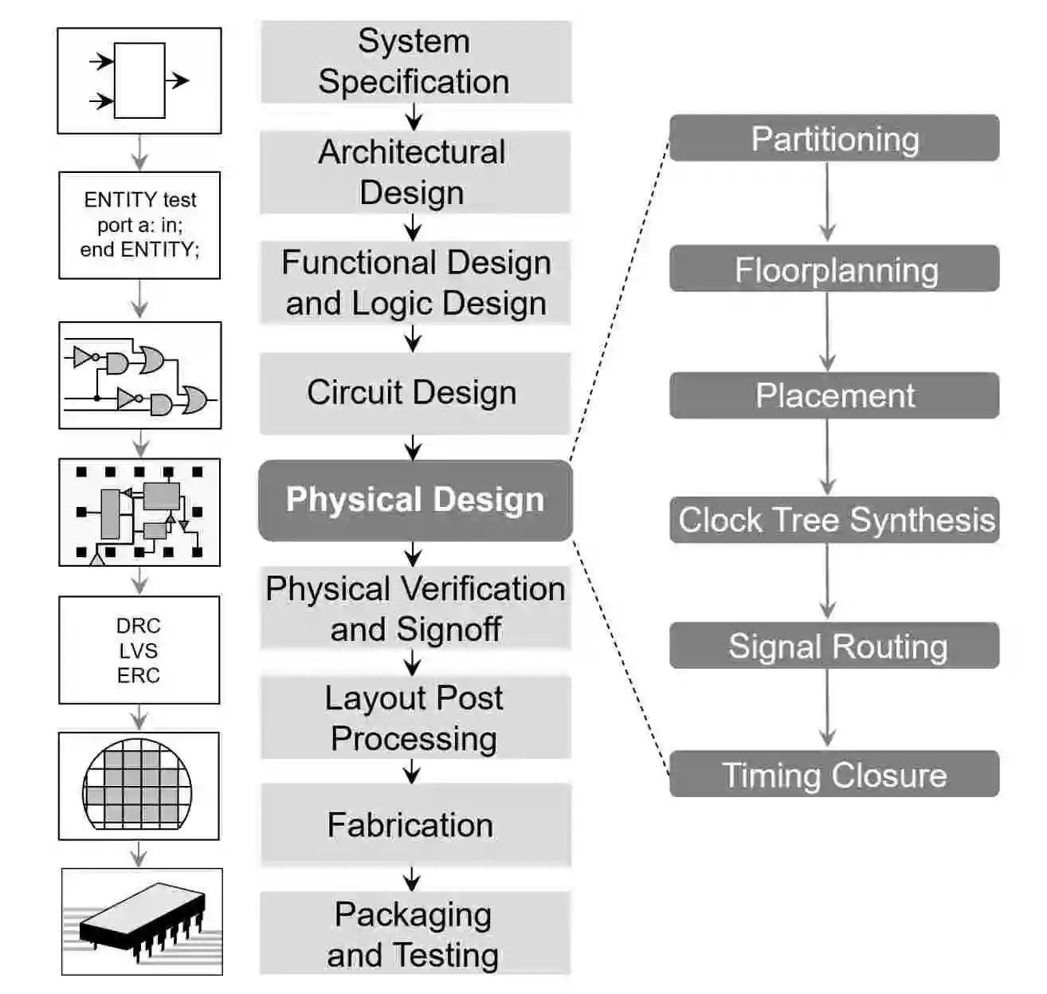
Overview and Goals
DESIGN FLOW

Slide 5
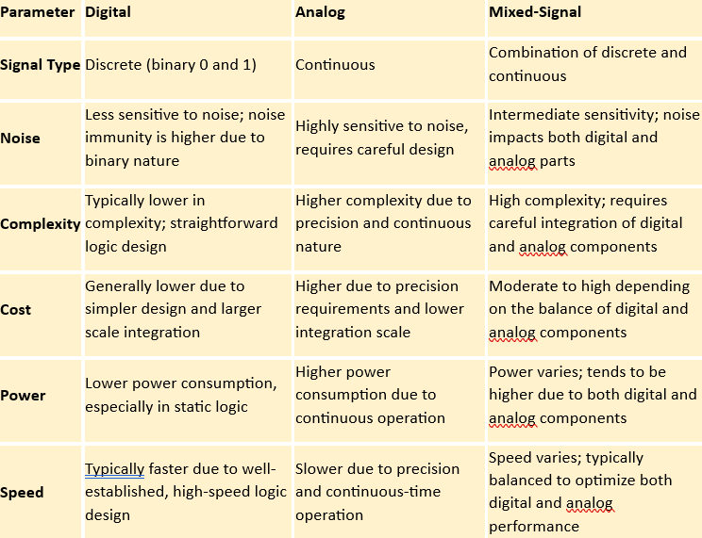
Overview and Goals
Overview

Slide 6
DIGITAL SYSTEMS
Overview and Goals
Overview
Logic Gates
Flip flops
Data storage
Sequential circuit design
Clocking and synchronous
State storage
Timing and delay
Low power design
Design of Digital Circuits
Implementation of Boolean Functions
Building Blocks for Modules
Optimization of Circuits
Timing and Synchronization
Power Management

Slide 7
ANALOG SYSTEMS :
Overview and Goals
Overview
OP-AMPS
ANALOG FILTERS
Amplification
Analog signal processing
ADCS
DACS
Feedback and control systems
Noise reduction
Low pass
High pass
Band pass
Band stop

Slide 8
Literature Survey
Key Publications:
VLSI DSP education
A Mixed-signal Analog-Digital Integrator Design
A case study of mixed-signal integrated circuit testing: an application of current testing using the upper limit and the lower limit
Key Resources:
IEEE(Institute of Electrical and Electronics Engineers)
References :
https://ieeexplore.ieee.org/document/409304
https://ieeexplore.ieee.org/abstract/document/6132448
https://ieeexplore.ieee.org/stamp/stamp.jsp?tp=&arnumber=471669

Slide 9
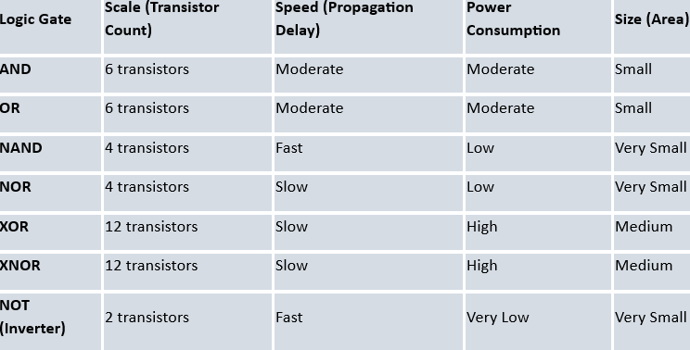
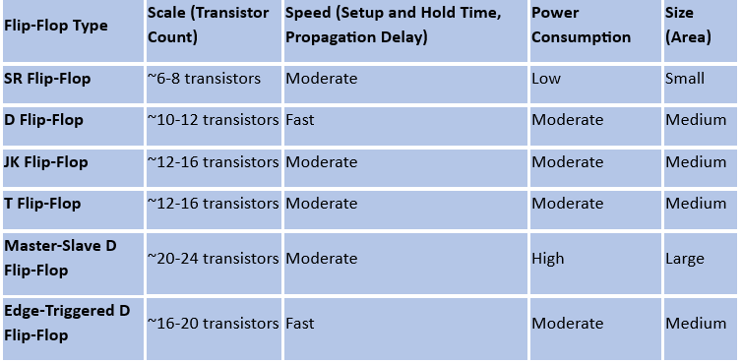
DIGITAL SYSTEMS :
LOGIC GATES
FLIP FLOPS

Slide 10
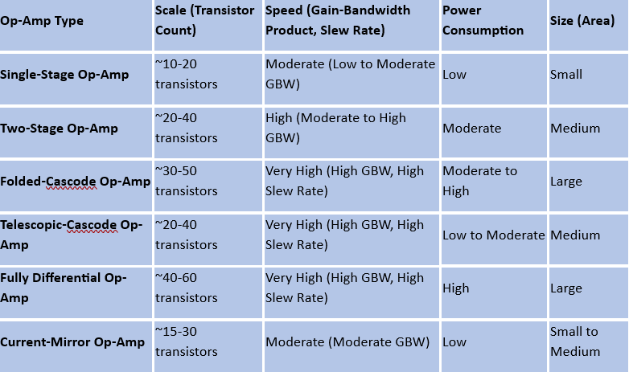
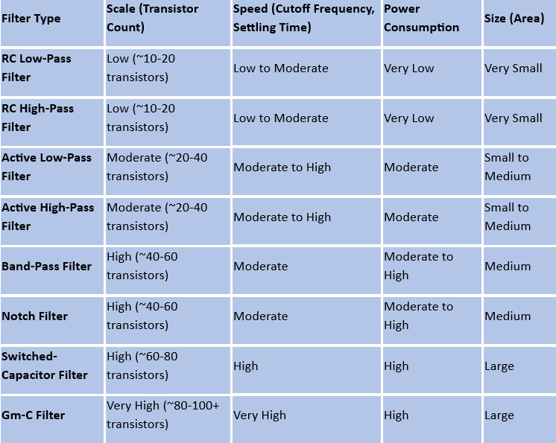
ANALOG SYSTEMS :[PARAMETERS]
Op-amp
Analog filter

Slide 11
CADENCE VIRTUOSO TOOL
Overview of Cadence Virtuoso
Definition:
A powerful EDA (Electronic Design Automation) platform for designing and verifying analog, digital, RF, and mixed-signal ICs.
Main Purpose:
Primarily used for custom IC layout, schematic capture, and simulation.
Enables precise design and analysis of complex integrated circuits.
Industry Usage:
Widely used by semiconductor companies for advanced IC design, especially in mixed-signal and analog domains.
Key Features and Capabilities for Design and Simulation
Schematic Capture:
Allows designers to create and edit detailed schematics of the ICs with high precision.
Intuitive interface for drawing and managing complex circuit diagrams.
Custom Layout:
Supports custom layout design with real-time DRC (Design Rule Check) and LVS (Layout vs. Schematic) to
ensure compliance with manufacturing constraints.
Layout editors enable detailed physical design, including placement of transistors, resistors, and interconnects.
Simulation and Verification:
Integrates with the Spectre® simulator for accurate analog/mixed-signal simulation and analysis.
Supports simulations for various parameters like voltage, current, power, and timing, allowing verification of circuit performance.

Slide 12
Importance in the Design Process
Precision and Accuracy:
Provides detailed modeling, layout, and simulation, which are crucial for ensuring first-pass success in silicon.
Reduces the risk of errors in the physical design that could lead to costly manufacturing defects.
Design Productivity:
Helps streamline the entire IC design flow by providing a unified environment for schematic, layout, and verification tasks.
Reduces time-to-market by facilitating fast iterations and accurate simulation.
Mixed-Signal and Analog Design:
Ideal for designs that require a high level of analog/mixed-signal precision, which is crucial in modern ICs like SoCs and RF circuits.
Ensures seamless integration of analog and digital components on a single chip.
Verification at Multiple Stages:
Supports verification at various stages (e.g., schematic-level, layout-level) to ensure that the design meets both functional and manufacturing specifications.
Early verification minimizes rework and improves overall design quality.
Industry Standard:
As an industry-standard tool, Virtuoso ensures compatibility with foundries and design partners, facilitating collaboration in large-scale projects.
Widely supported across various semiconductor foundries for fabrication.
Supports Advanced Technologies:
Critical for designing in leading-edge technologies like FinFETs and FDSOI (Fully Depleted SOI), used in high-performance, low-power devices.

Slide 13
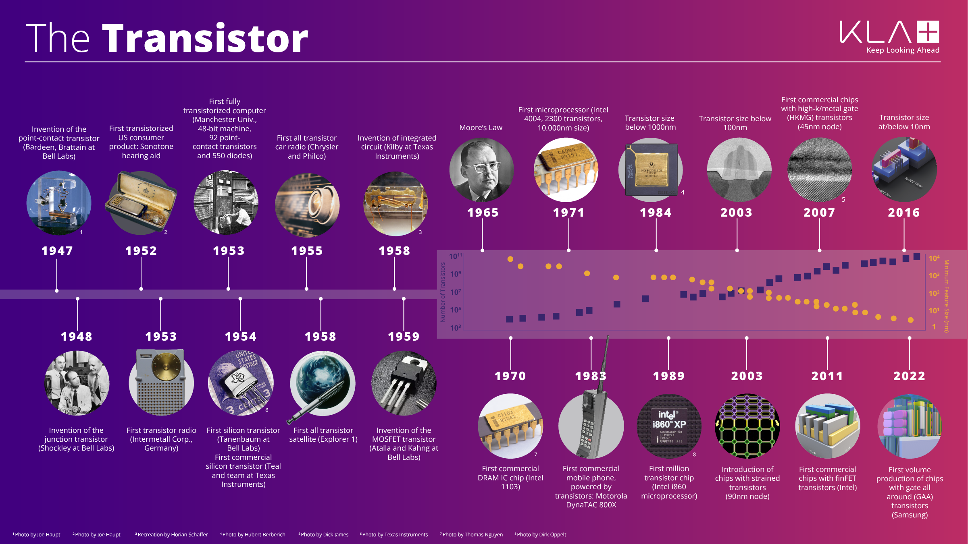
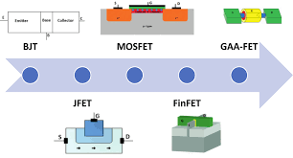
EVALUATION OF A TRANSISTOR :
KLA Celebrates the 75th Anniversary of the Transistor | Innovation | KLA

Slide 14
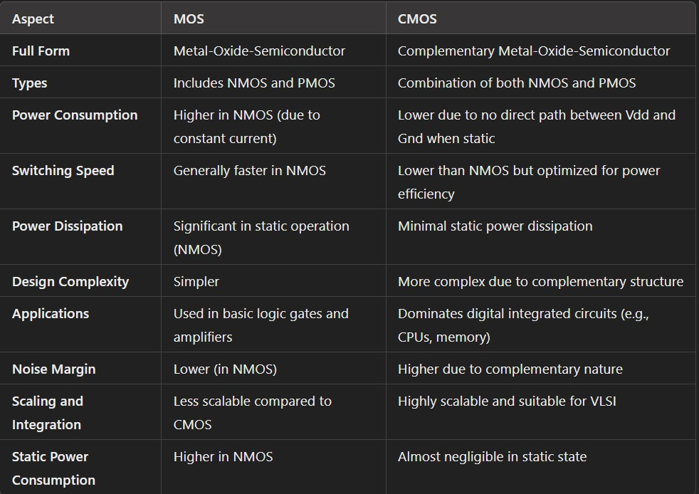
CMOS vs MOSFET :

Slide 15
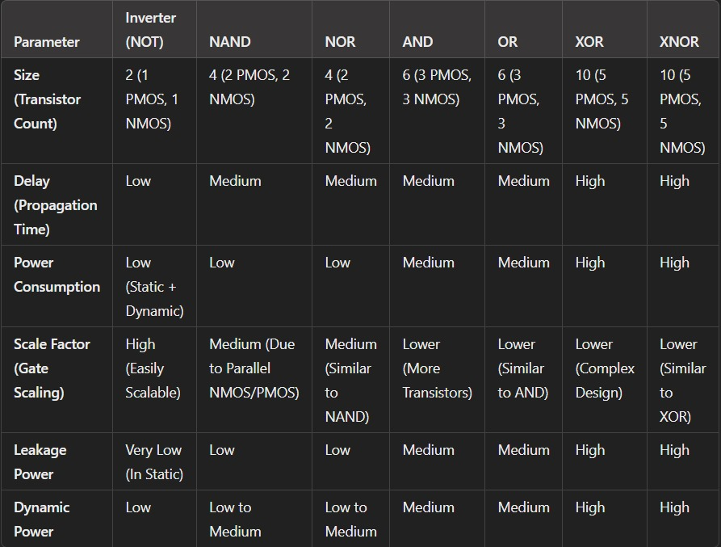
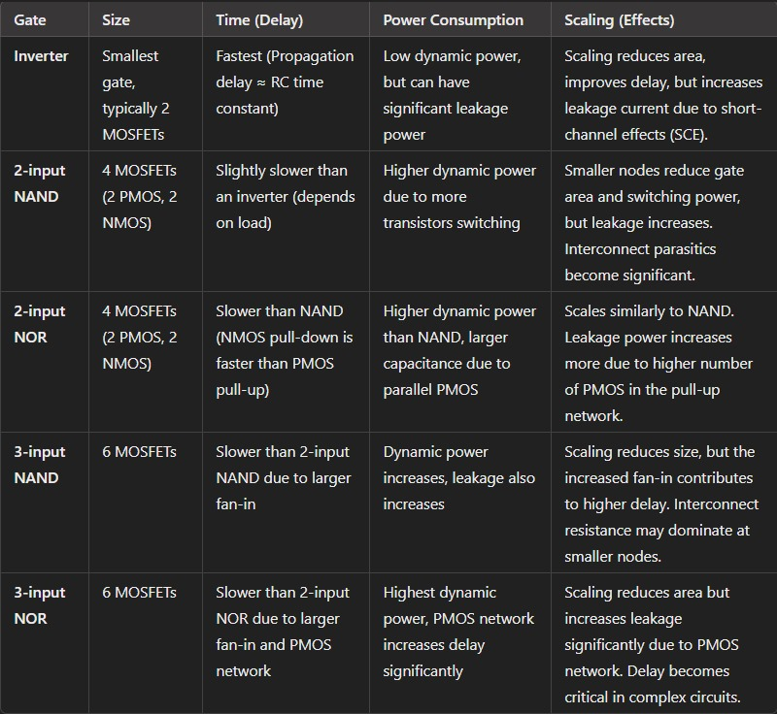
Logic gates parameters :
CMOS
MOSFET
POP_Ch3-4.pdf (jh.edu)

Slide 16
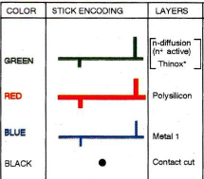
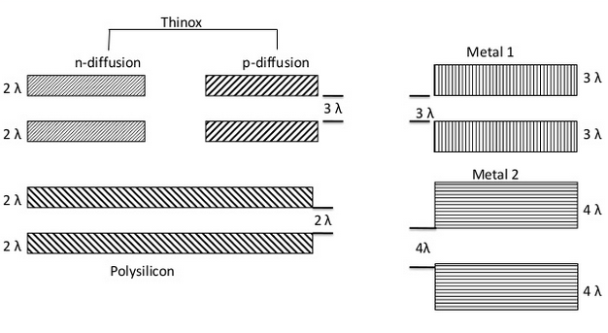
DESIGN RULES :
MOS
CMOS

Slide 17
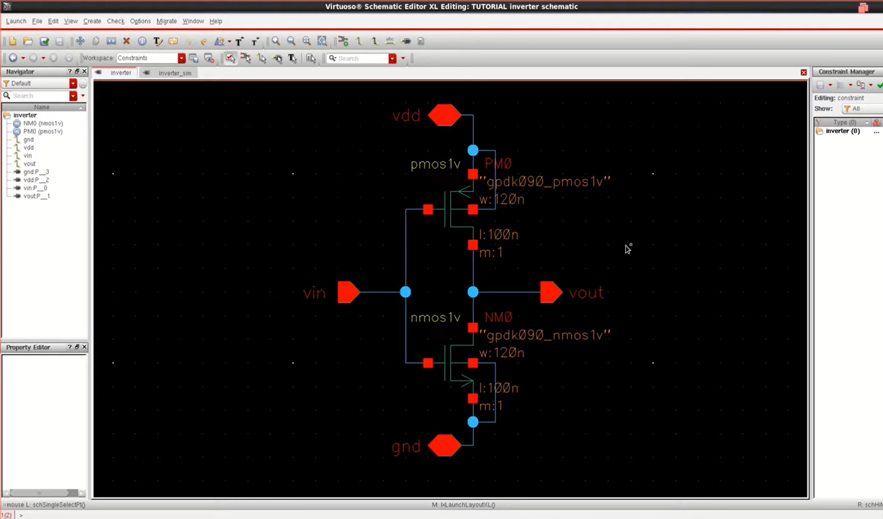
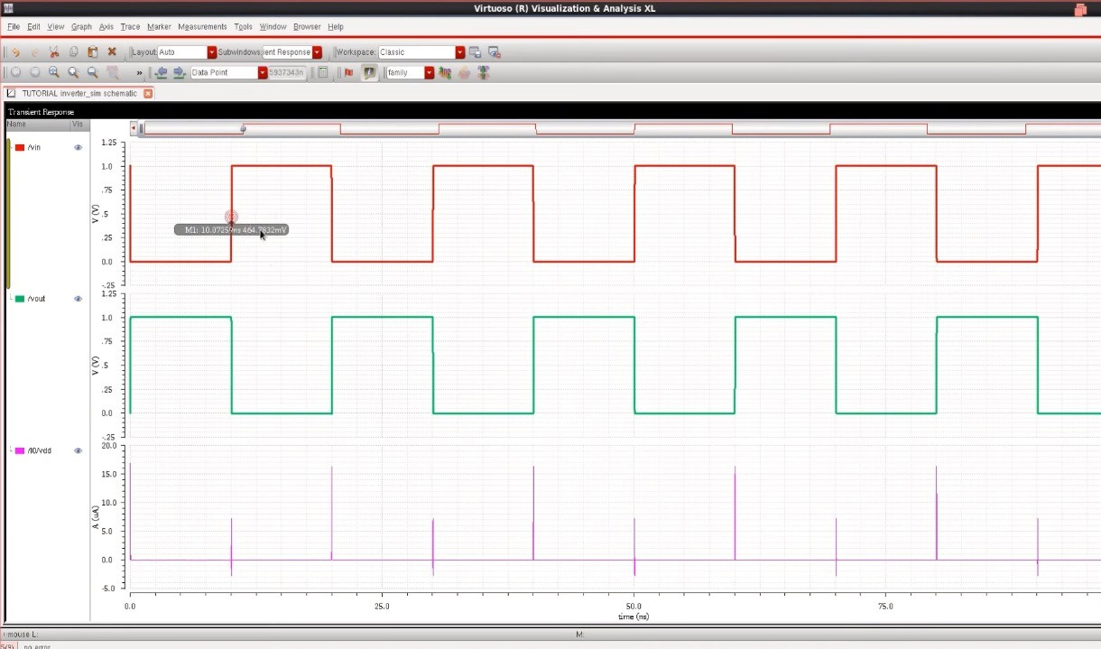
CMOS technology : [invertor]
schematic
TRANSIENT

Slide 18
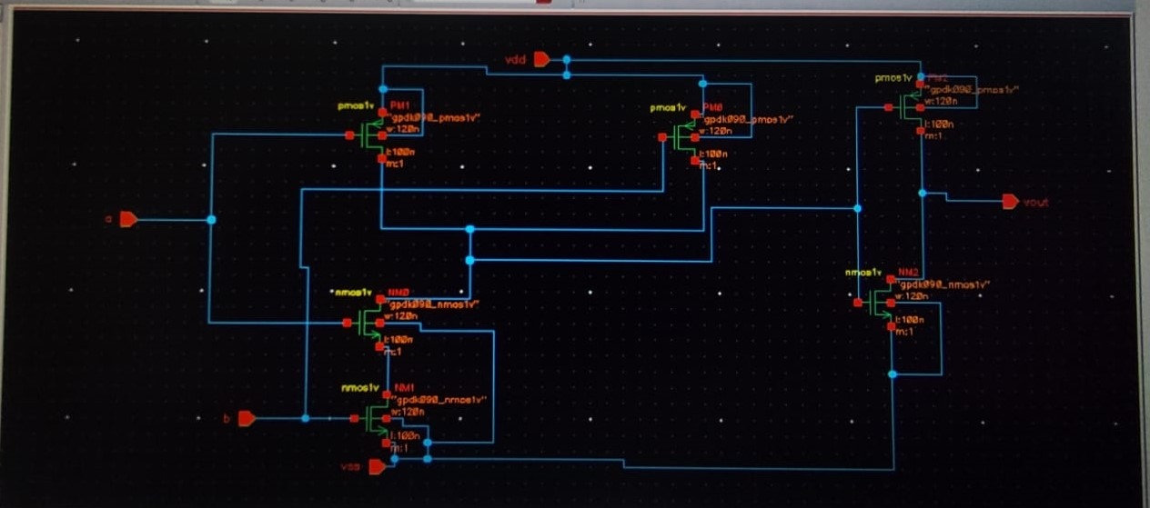
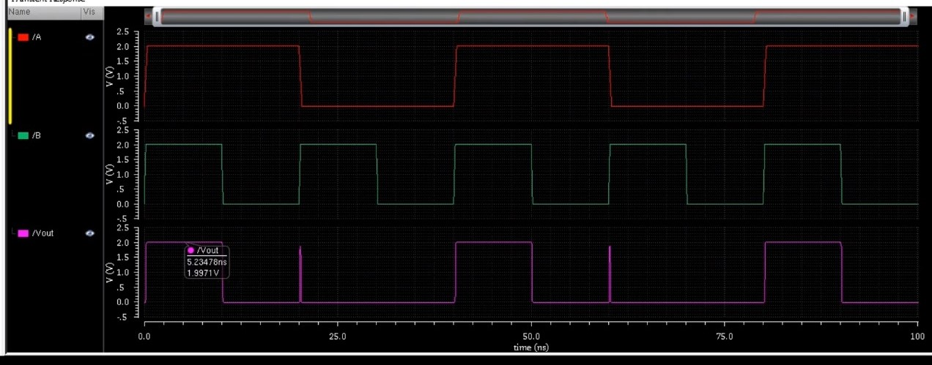
CMOS Technology :[AND GATE ]
SCHEMATIC
TRANSIENT

Slide 19
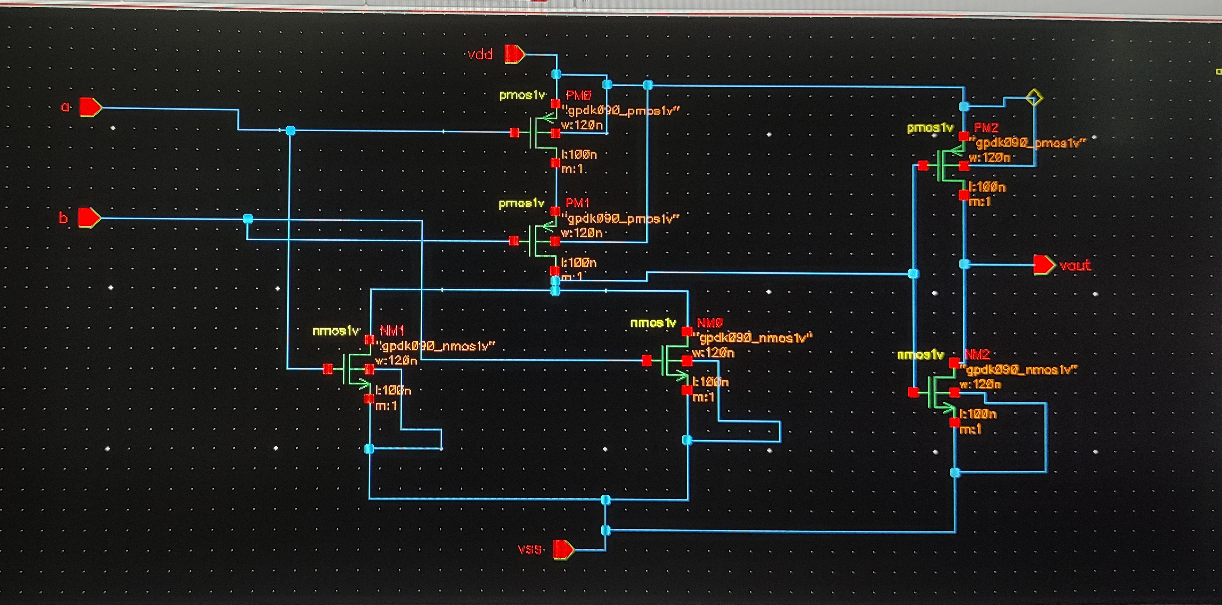
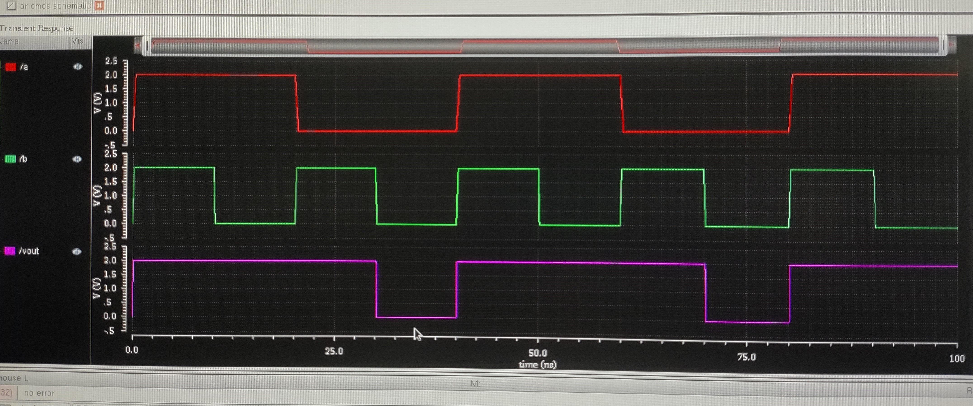
CMOS Technology :[OR GATE]
SCHEMATIC
TRANSIENT

Slide 20
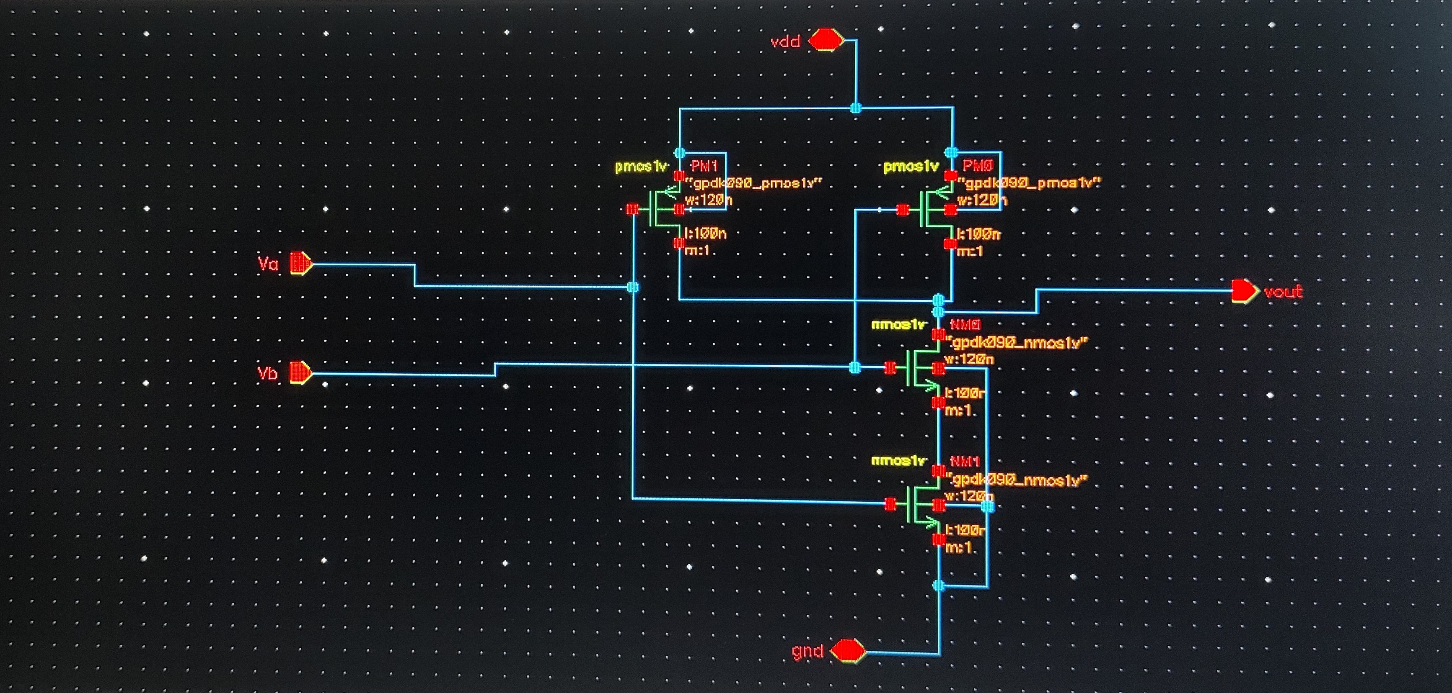
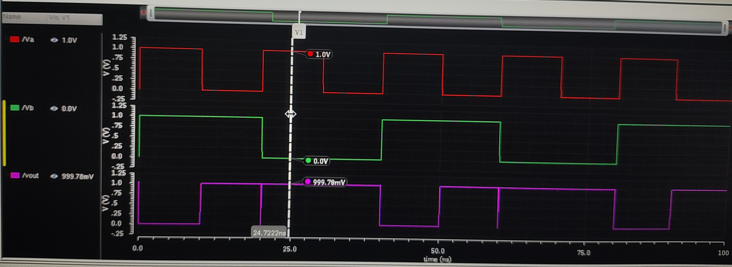
CMOS Technology :[NAND GATE-active high]
SCHEMATIC
TRANSIENT

Slide 21
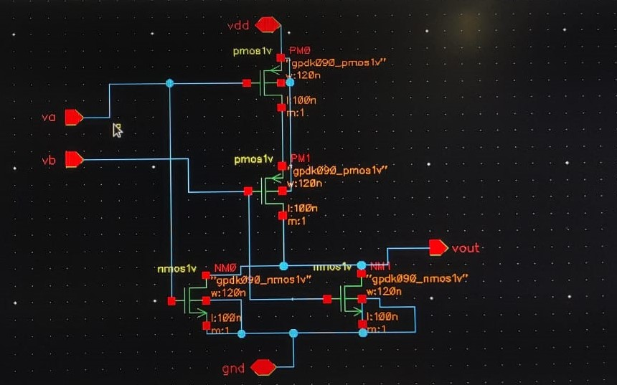
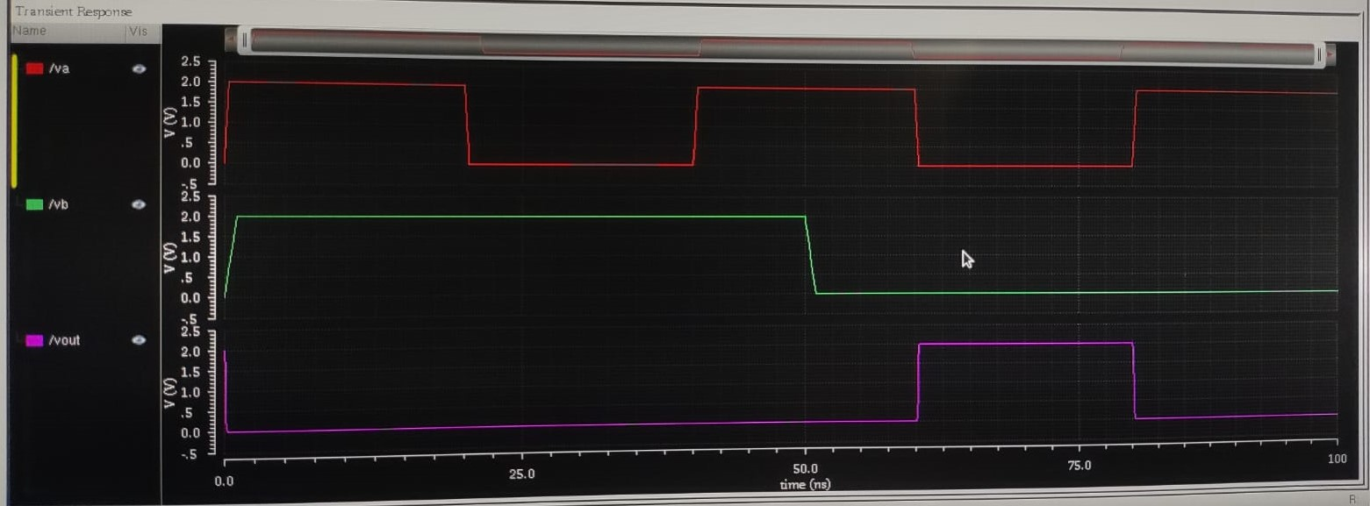
CMOS Technology :[NOR GATE]
SCHEMATIC
TRANSIENT

Slide 22
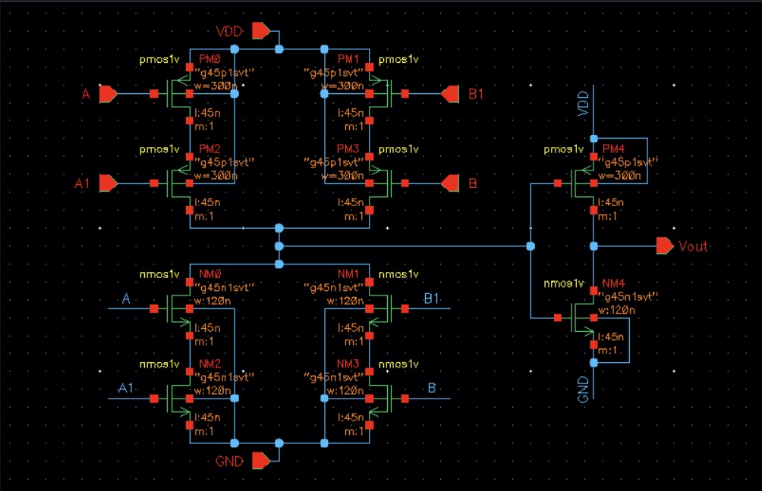
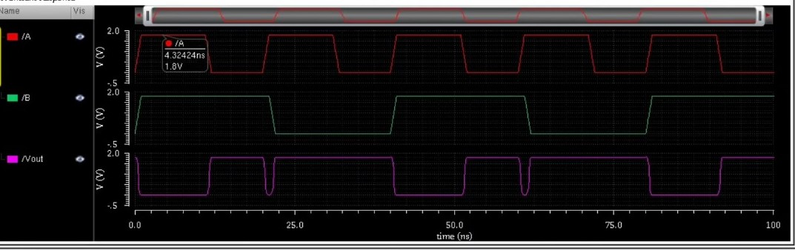
CMOS Technology :[EX-OR GATE]
SCHEMATIC
TRANSIENT

Slide 23
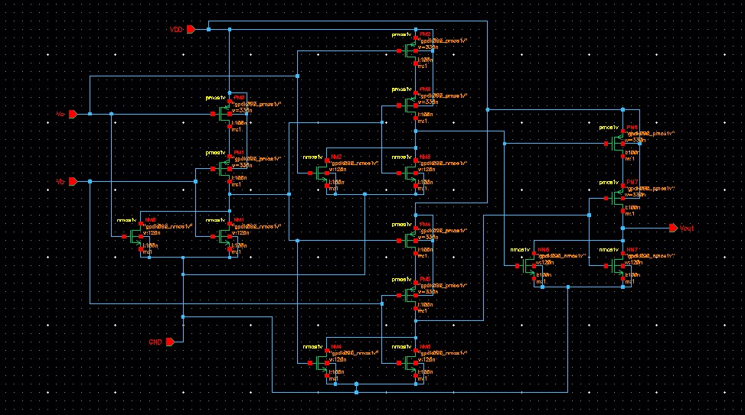
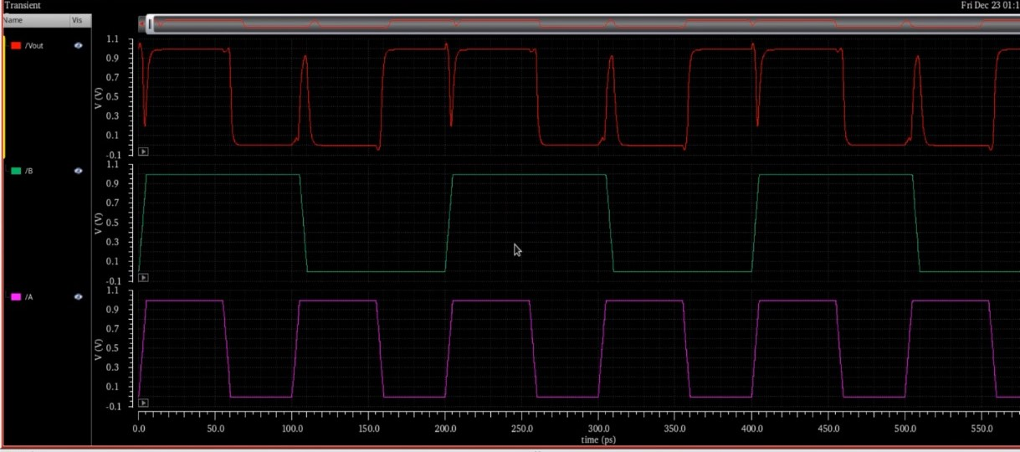
CMOS Technology :[EX-NOR GATE]
SCHEMATIC
TRANSIENT

Slide 24
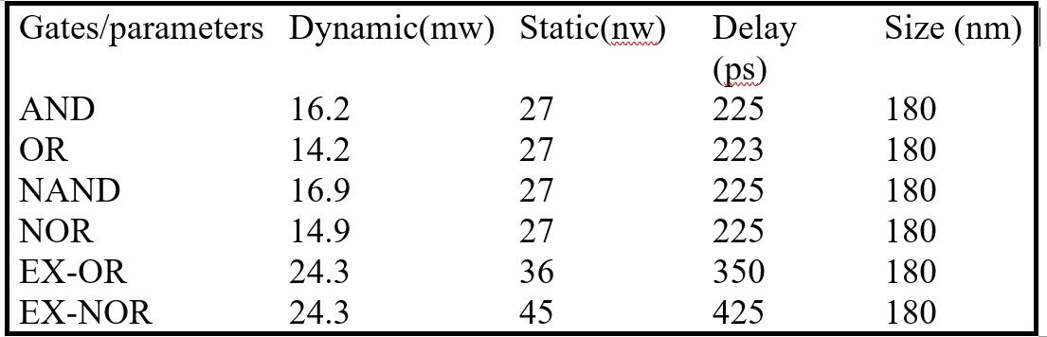
Results :

Slide 25
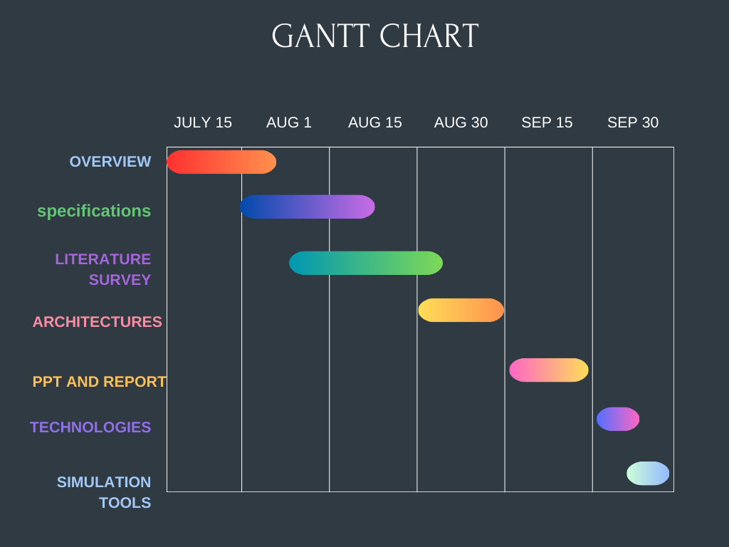
Project Plan
Gant Chart - Milestones and Activities

Slide 26
Analysis – 4W1H
What : The purpose is to design and optimize VLSI systems that effectively handle real-world data, ensure precision in computing, and integrate both types of signals for versatile functionality.
Why :We need to study analog, digital, and mixed signals across different architectures in VLSI design to optimize the performance, efficiency, and integration of complex electronic systems.
Where:We study analog, digital, and mixed signals in VLSI design to optimize and integrate various electronic functions within a single chip for efficient and effective signal processing.
How :"By integrating and optimizing analog, digital, and mixed signals within VLSI architectures, we enhance the performance and efficiency of complex electronic systems."
When : We study analog, digital, and mixed signals across different architectures in VLSI design to optimize the integration and performance of complex electronic systems.
Refined Objective:
Optimization
Performance
Digital-Analog-Mixed Signal Analysis

Slide 27
Analysis - SWOT
Strengths
Weaknesses
Versatile Skillset: Mastery of multiple signal types broadens problem-solving capabilities.
System Integration: Essential for designing and optimizing modern, integrated systems
Complexity: Learning requires deep understanding across diverse domains.
Resource-Intensive: Advanced tools and significant time investment needed.
Threats
Opportunities
Rapid Tech Changes: Knowledge can become outdated quickly.
Competition: Field is competitive due to its importance in technology.
High Demand: Growing need for mixed-signal expertise in various industries.
Innovation: Potential to pioneer new, efficient system architectures.

Slide 28
Conclusion & Future Work
Conclusion:
In conclusion, the study of digital, analog, and mixed-signal systems across different architectures reveals the strengths and limitations of each approach in various applications. Digital systems offer precision and programmability, while analog systems excel in real-time processing. Mixed-signal systems combine the best of both worlds, providing a balanced solution for complex, real-world challenges.
Future Work:
Architectures: Future work will focus on designing more efficient and adaptable architectures that improve the performance and integration of digital, analog, and mixed-signal systems.
Implementation Tools: Developing and enhancing tools that simplify and optimize the implementation of complex mixed-signal designs will be a key area of future work.
First Implementation: The first implementation will involve creating prototypes to test the practicality and performance of the new architectures and tools in real-world scenarios.
Evaluation and Validation: Future efforts will include rigorous evaluation and validation of the implemented systems to ensure they meet performance standards and reliability in various applications.

Slide 29
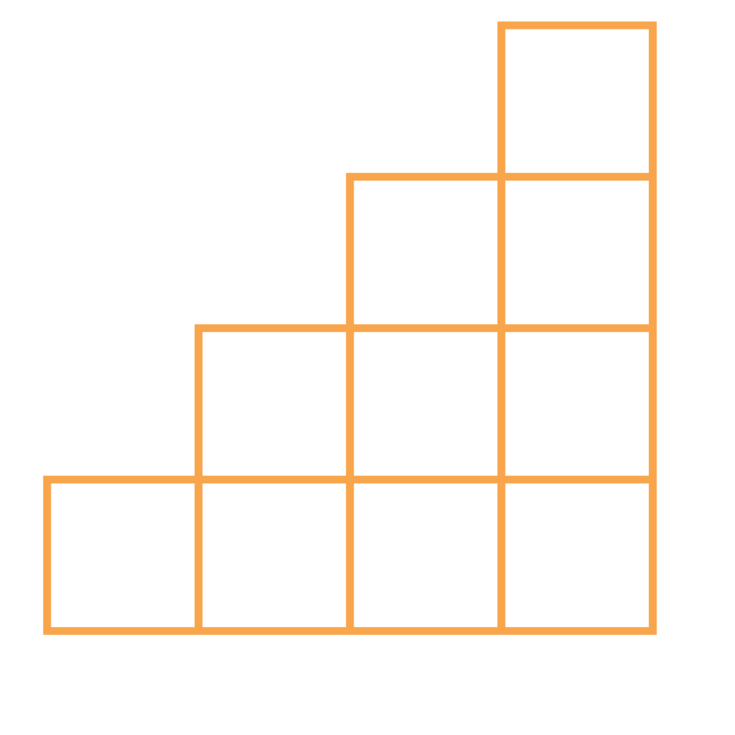
THANK YOU

